Slide 1
The Ames Housing Dataset
Predicting House Prices with Linear Regression
Nandhini Manoharan

Slide 2
Problem Statement
Determine the best model for predicting the Saleprice of houses in Ames.
What features add most value to a house and what decreases the house values?
What kind of house one could buy given their budget?
What is the expected price of a house with a set of features?

Slide 3
Workflow
Data Cleaning & Preprocessing
EDA
Feature Selection
Modelling and Evaluation

Slide 4
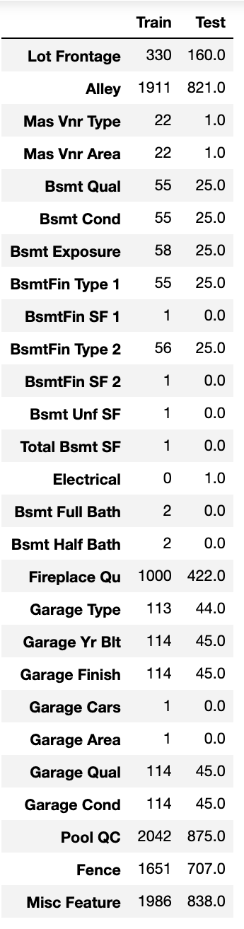
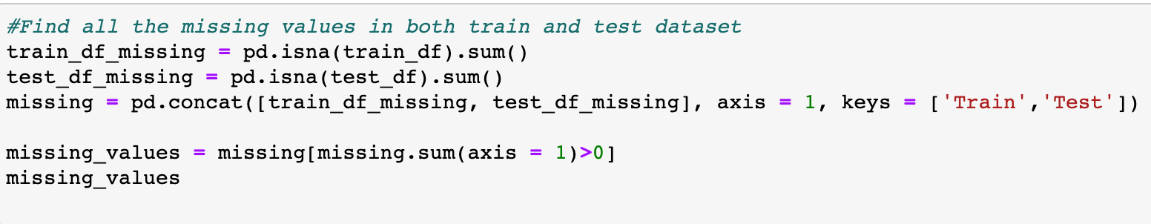
Missing Values

Slide 5
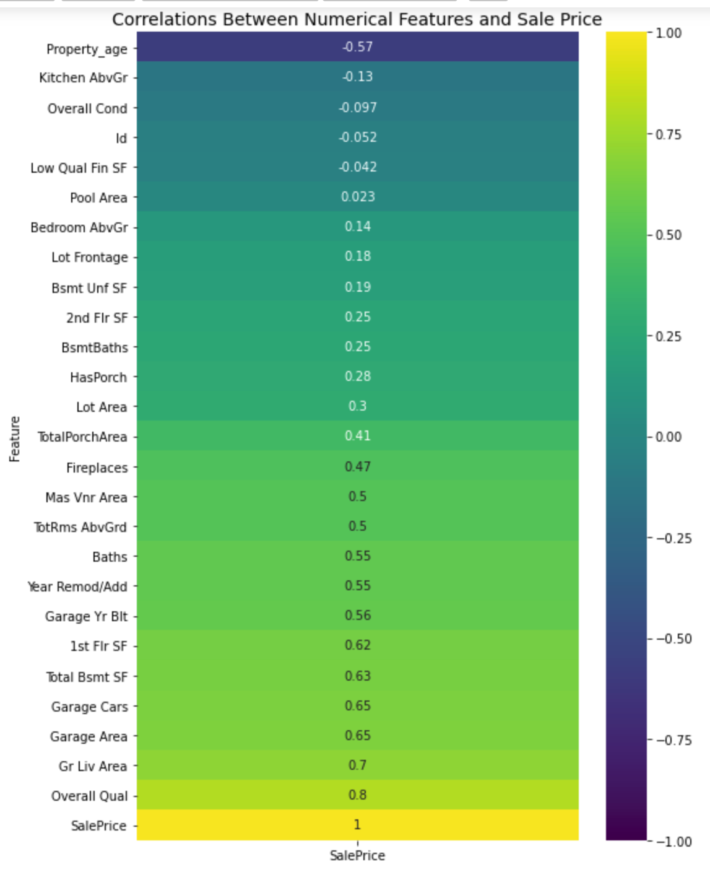
Correlation

Slide 6
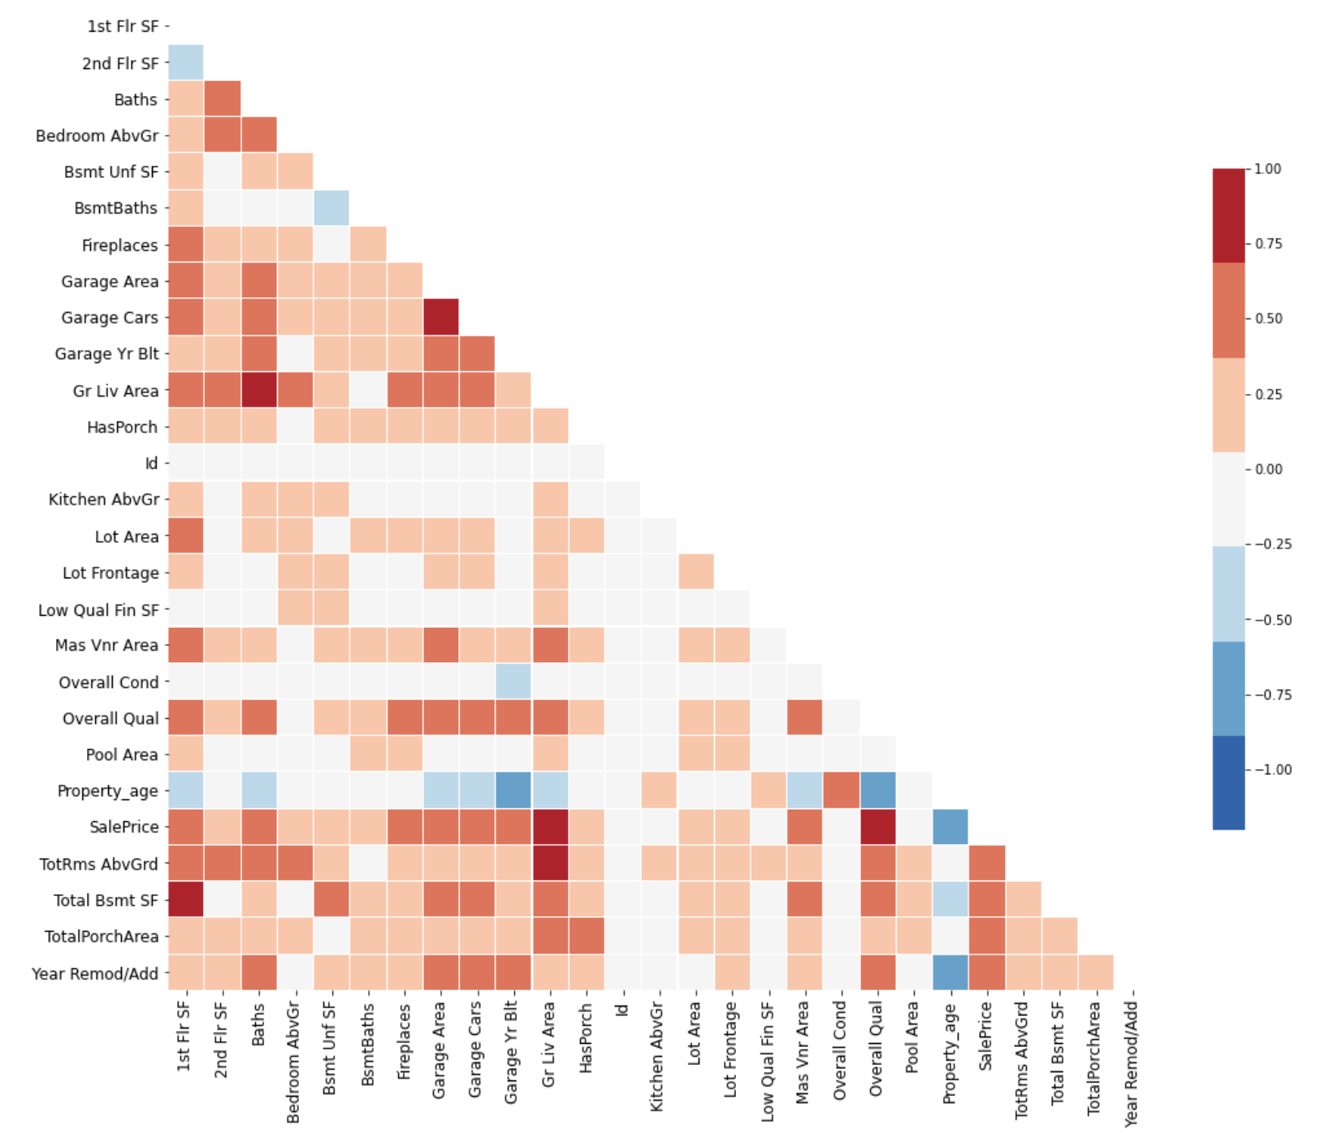
Multicollinearity

Slide 7
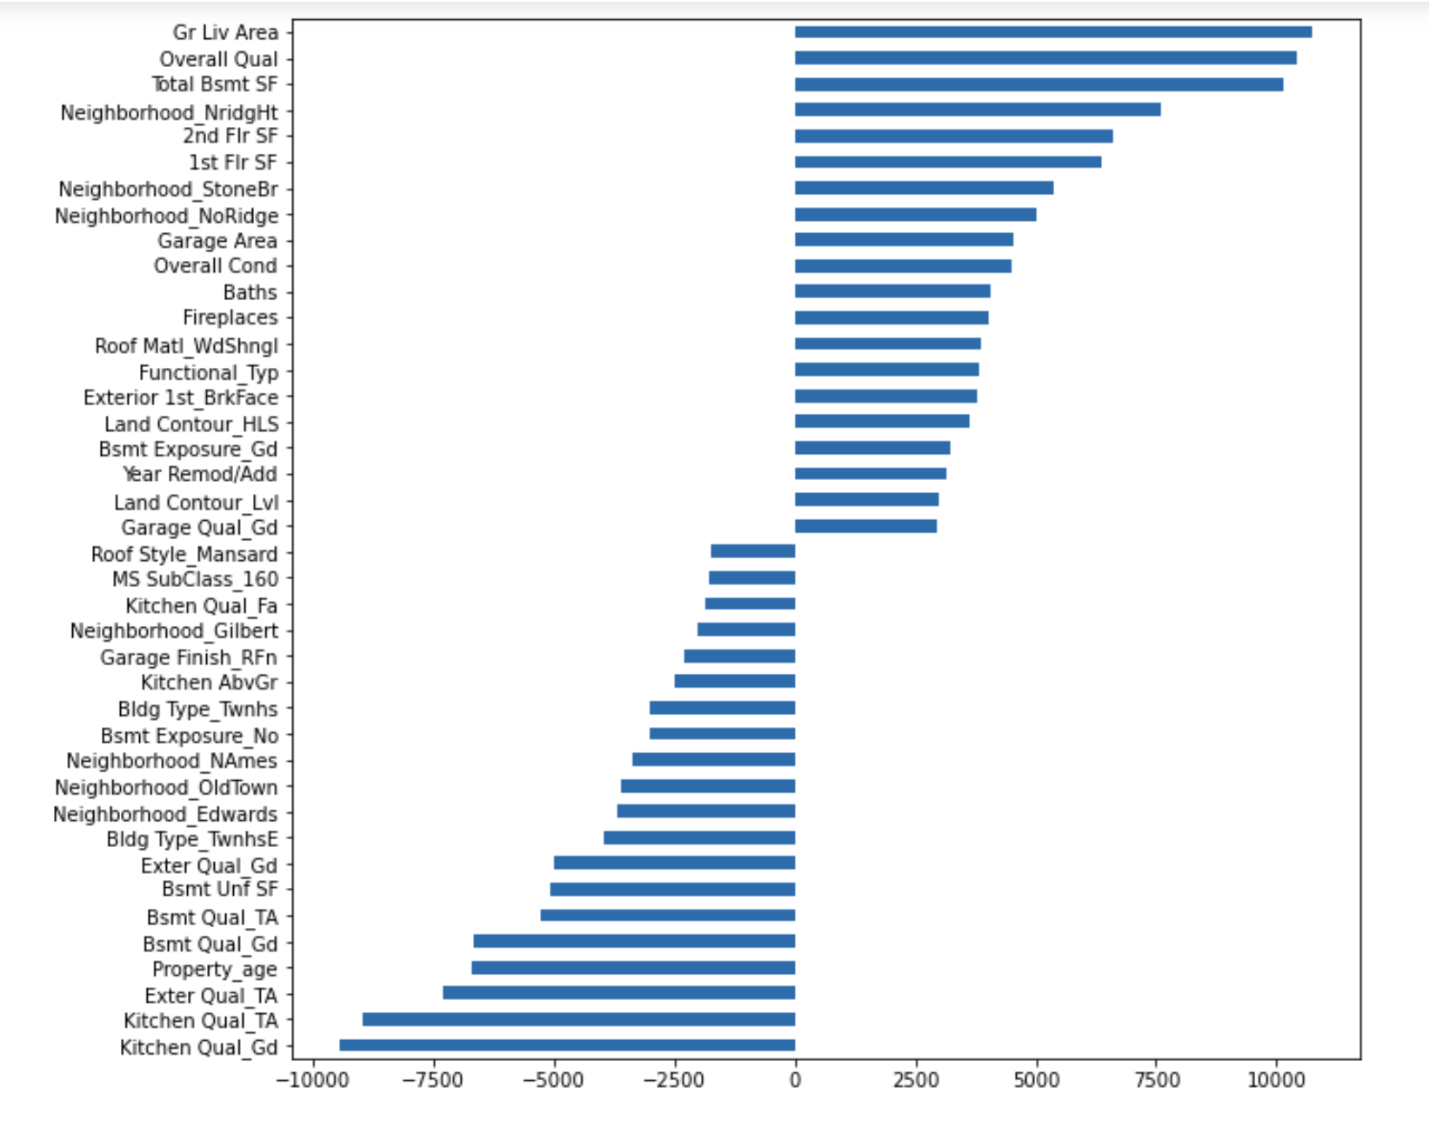
Features with highest Coefficients

Slide 8
Summary of findings
Lasso model was the best performing in terms of R2 and MSE.
Square feet area, property age, Overall conditions and location are the most important determinant factors of Saleprice
Best locations are - Northridge Heights, Stone Brook and Northridge
People looking to sell should do it sooner rather than later
To increase the value of a home:
Renovate the kitchen
Remodel the interior and exterior finish
Add fireplace(if not present)
Renovate Garage
Renovate house if not in good condition

